Slide 1
Why have Human Identity Testing?
Forensic/criminal cases – identify a perpetrator
Paternity testing
Historical investigations – Jefferson/Hemings
Mass disasters – mass graves, mudslides
Military DNA “dog tag”

Slide 2
DNA for Identity
Son’s DNA & Discarded Pizza Slice ID Suspect in 10 ‘Grim Sleeper’ Murders in 2010
2018, Project Innocence celebrates 25th anniversary, 363 DNA exoneration cases.

Slide 3

FBI’s CODIS DNA Database:
Combined DNA Index System
Tries to link serial crimes & unsolved cases with repeat offenders
Began in October 1998
>13 million offender profiles
>887,000 forensic samples
435,887 hits assisting in more than 424,268 investigations (Sept 2018)

Slide 4
CODIS Profile
Locus | D3S1358 | vWA | FGA | D8S1179 | D21S11 | D18S51 | D5S818
Genotype | 15, 18 | 16, 16 | 19, 24 | 12,13 | 29, 31 | 12, 13 | 11, 13
Locus | D13S317 | D7S820 | D16S539 | THO1 | TPOX | CSF1PO | AMEL
Genotype | 11, 11 | 10, 10 | 11, 11 | 9, 9.3 | 8, 8 | 11, 11 | X Y
Standard for police work & paternity testing, DNA not sequenced!

Slide 5
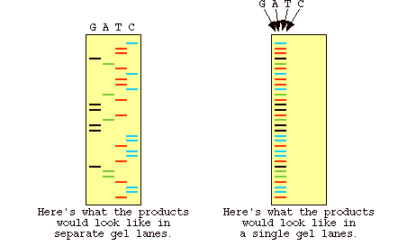
DNA Sequencing
Cost 1st human genome - $3 billion, $1/base in 2003
Your human genome today ~ $2000
Sequencing PCR runs, >$10

Slide 6
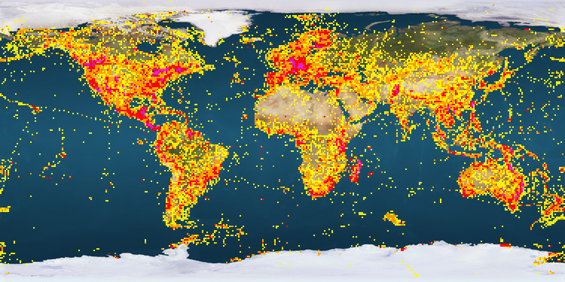
DNA Barcoding

Slide 7
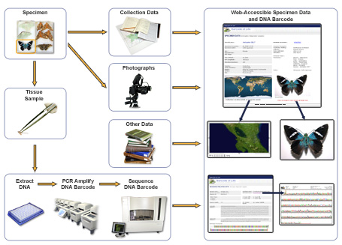
DNA Barcoding – sequenced!

Slide 8
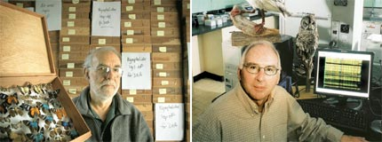

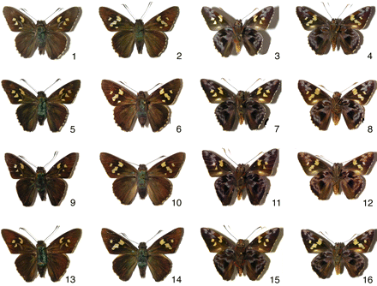
How many species of skippers?

Slide 9

DNA Barcoding
Who eats what?

Slide 10
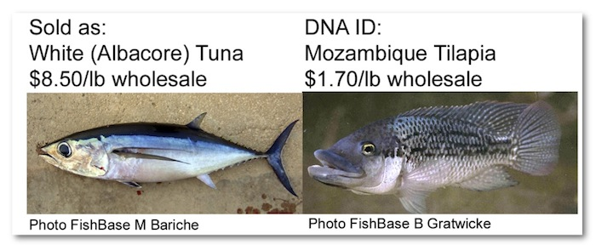
DNA Barcoding – you paid what for that fish?
15
3

Slide 11

SushiGate
2008 – HS Students
http://phe.rockefeller.edu/barcode/sushigate.html

